Slide 1
Tri-Roll Comparator
ME 580 Project

Slide 2
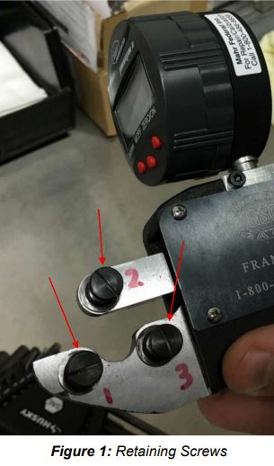
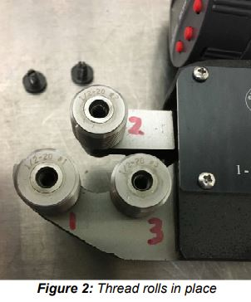
Tri Rollers

Slide 3
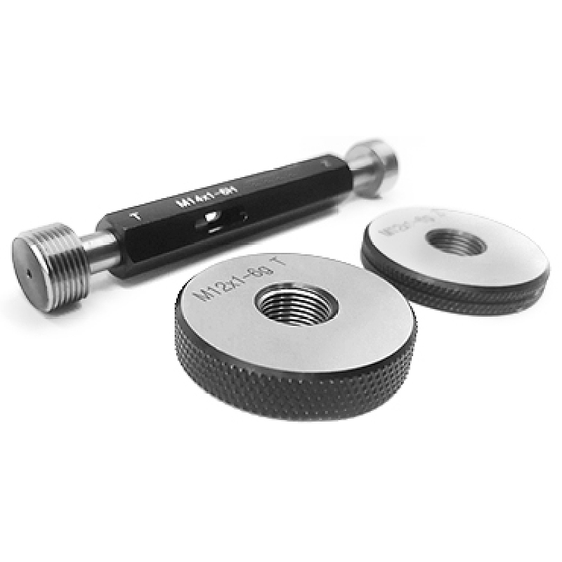
Previous Equipment Go/NoGo Gauges

Slide 4
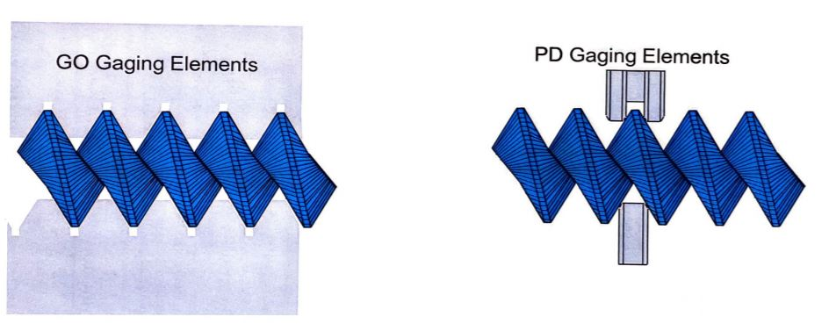
Equipment Comparison

Slide 5
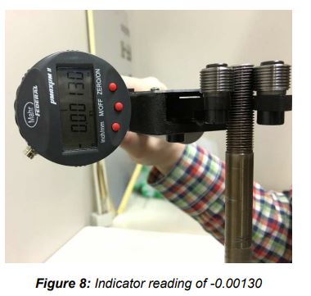
Inspection

Slide 6
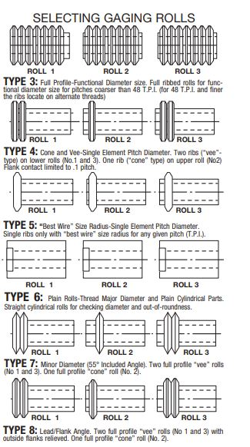
Gauge Rolls

Slide 7
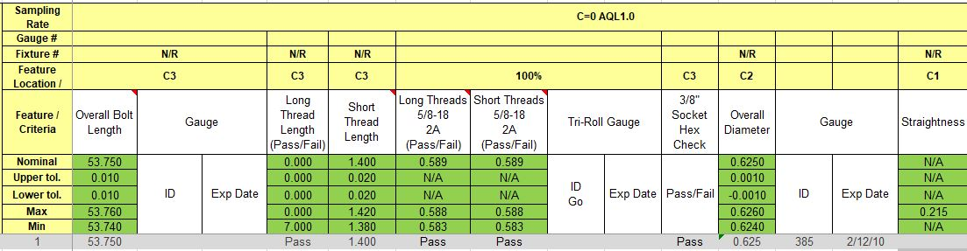
Inspection Criteria

Slide 8
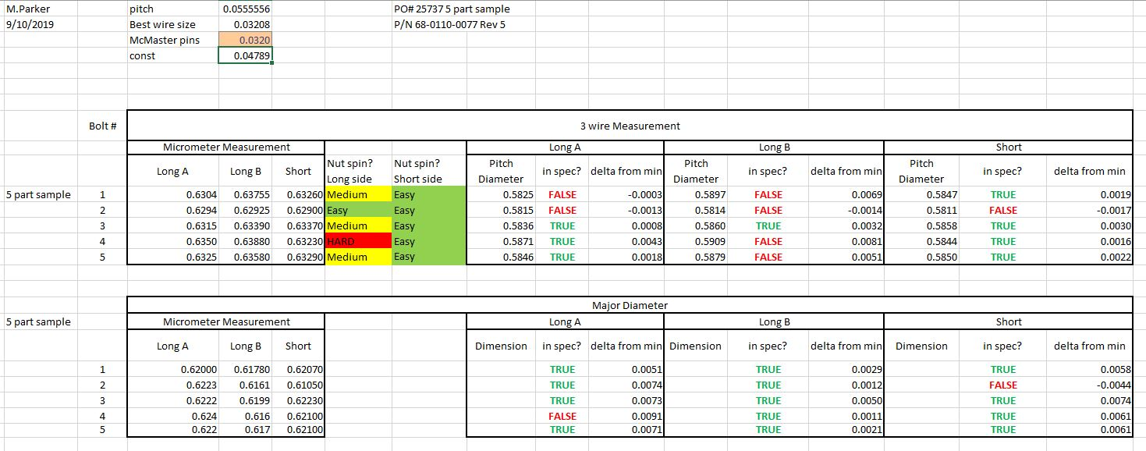
3-Wire Measurements

Slide 9
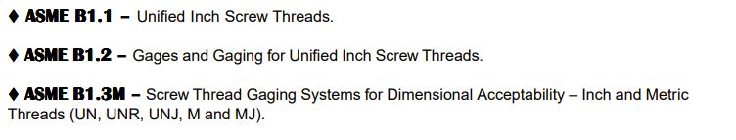
ASME Standards

Slide 10
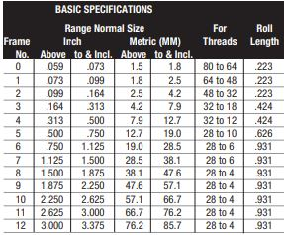
Company 1 : ThreadCheck

Slide 11
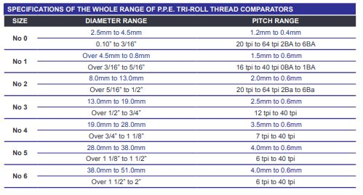
Company 2: Apex Tool Group

Slide 12
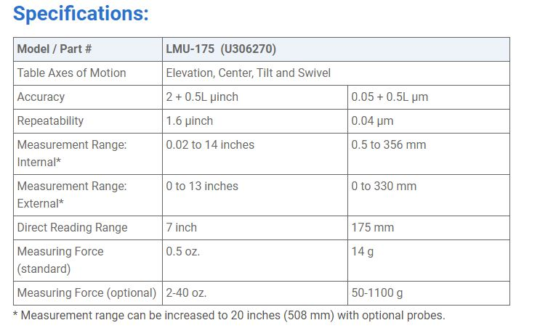
Company 3: Pratt and Whitney Products

Slide 13
Voice of Customer Survey
Unsatisfactory
Satisfactory
Survey Questions
1
Product and Measurement
Do all parts and assemblies meet desired quality specifications?
Does the product meet the expected length of life?
Is there an appropriate range of options for the product?
Is there consistency in the quality of the product?
Does the design meet requirements?
2
Training and Service
Is the provided training adequate for a foundational earning process?
Is the provided service adequate for repairing the product?
Is the provided service cover a range of issues?
Is the provided training efficient and effective?
3
Ease of Operation
Can the product be operated easily?
Is operation of the product reliable?
How easily can a new operator learn to use the product?
Can operators quickly turn over parts using the product?
4
Company
Is the product consistent with the reputation of the company?
Does the product encourage considerations for additional products from the company?
Is there clarity in interactions with the company?
5
Price
Does the price of the product reflect market prices for similar products?
Does the product provide the expected value for the price?
Is the product prices adequately for overall cost of use?

Slide 14
Relative Weights of Customer’s Voice and Engineering Characteristics
Weight of Engineering Characteristics
Weight of Customer’s Voice
Survey Questions
1
Product and Measurement
0.30
0.15
Do all parts and assemblies meet desired quality specifications?
Does the product meet the expected length of life?
Is there an appropriate range of options for the product?
Is there consistency in the quality of the product?
Does the design meet requirements?
2
Training and Service
0.10
0.25
Is the provided training adequate for a foundational earning process?
Is the provided service adequate for repairing the product?
Is the provided service cover a range of issues?
Is the provided training efficient and effective?
3
Ease of Operation
0.30
0.25
Can the product be operated easily?
Is operation of the product reliable?
How easily can a new operator learn to use the product?
Can operators quickly turn over parts using the product?
4
Company
0.10
0.20
Is the product consistent with the reputation of the company?
Does the product encourage considerations for additional products from the company?
Is there clarity in interactions with the company?
5
Price
0.20
0.15
Does the price of the product reflect market prices for similar products?
Does the product provide the expected value for the price?
Is the product prices adequately for overall cost of use?

Slide 15
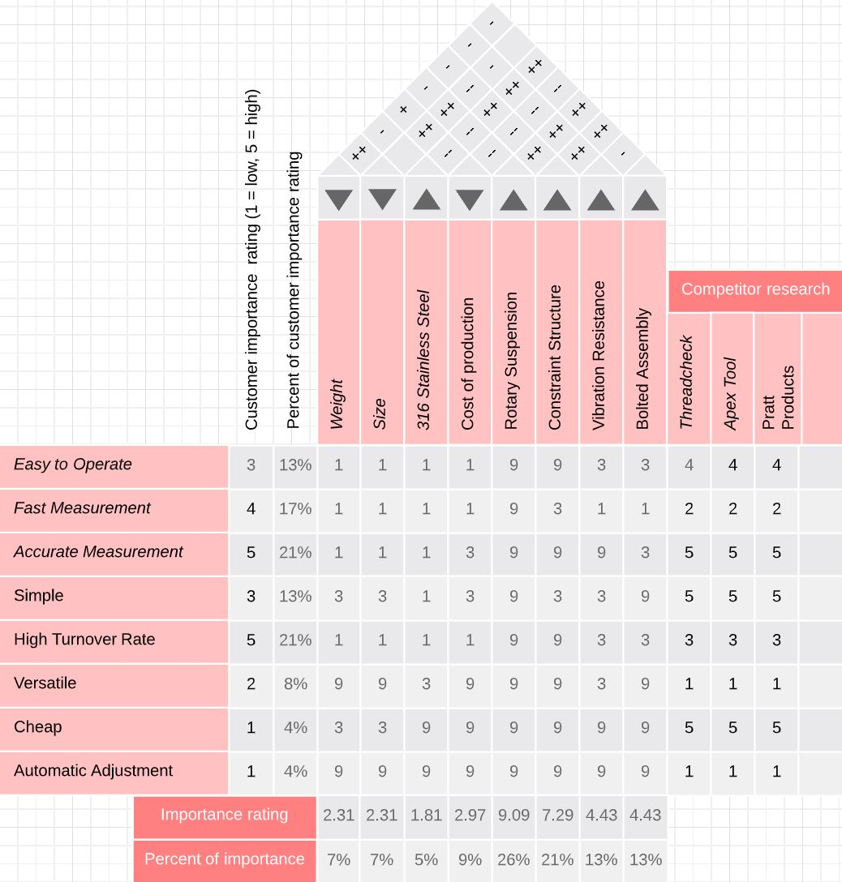
House of Quality (Focus on Engineering Characteristics)

Slide 16
House of Quality
Complexity and features impact production cost and reliability
Materials are important
High part turnover rate is critical
Precision is critical
Reliability is critical

Slide 17
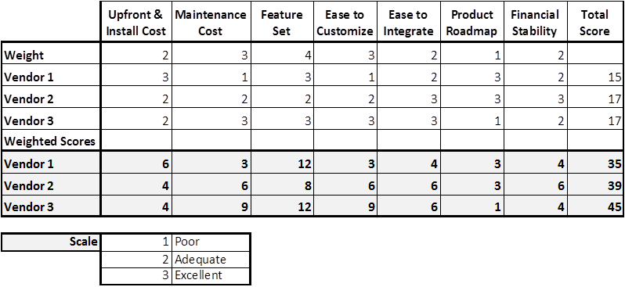
Weighted Decision Matrix
Vendor 1: Threadcheck
Vendor 2: Apex Tool Group
Vendor 3: Pratt and Whitney Products

